Slide 1
The Computational Complexity of Satisfiability

Slide 2
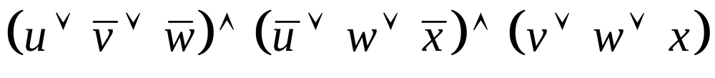
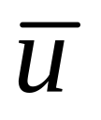
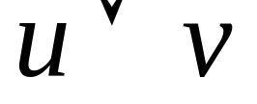
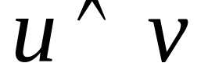
Boolean Formula
u v w x: variables take on TRUE or FALSE
NOT u
u OR v
u AND v

Slide 3
Assignment
u → TRUE
v → FALSE
w → FALSE
x → TRUE

Slide 4
Satisfying Assignment
u → TRUE
v → FALSE
w → TRUE
x → TRUE

Slide 5
Satisfiability
A formula is satisfiable if it has a satisfying assignment.
SAT is the set of formula with satisfying assignments.
SAT is in the class NP, the set of problems with easily verifiable witnesses.

Slide 6
NP-Completeness of SAT
In 1971, Cook and Levin showed that SAT is NP-complete.

Slide 7
NP-Completeness of SAT
SAT
A
In 1971, Cook and Levin showed that SAT is NP-complete.
  Every set A in NP reduces to SAT.

Slide 8
NP-Completeness of SAT
SAT
f
A
In 1971, Cook and Levin showed that SAT is NP-complete.
  Every set A in NP reduces to SAT.

Slide 9
NP-Completeness of SAT
SAT
f
A
True even for SAT in 3-CNF form.

Slide 10
NP-Complete Problems
SAT has same complexity as
  Map Coloring
  Traveling Salesman
  Job Scheduling
  Integer Programming
  Clique
  …

Slide 11
Questions about SAT
How much time and memory do we need to determine satisfiability?
Can one prove that a formula is
not satisfiable?
Are two SAT questions better
than one?
Is SAT the same as every other NP-complete set?
Can we solve SAT quickly on other models of computation?

Slide 12
How Much Time and Memory Do We Need to Determine Satisfiability?

Slide 13
Solving SAT
2^{n}
T
I
M
E
n
n
log n
SPACE

Slide 14
Solving SAT
Search all of the assignments.
Best known for general formulas.
2^{n}
T
I
M
E
n
n
log n
SPACE

Slide 15
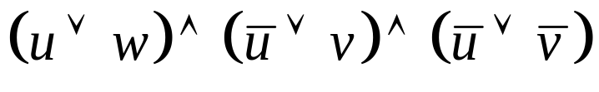
Solving SAT
Can solve 2-CNF formula quickly.
2^{n}
T
I
M
E
n
2-CNF
n
log n
SPACE

Slide 16
Solving SAT
2^{n}
T
I
M
E
n
n
log n
SPACE

Slide 17
Solving SAT
Schöning (1999)
3-CNF satisfiability
solvable in
time (4/3)^{n}
2^{n}
1.33^{n}
3-CNF
T
I
M
E
n
n
log n
SPACE

Slide 18
Schöning’s Algorithm
Pick an assignment a at random.
Repeat 3n times:
  If a is satisfying then HALT
  Pick an unsatisfied clause.
  Pick a random variable x in that clause.
  Flip the truth value of a(x).
Pick a new a and try again.

Slide 19
Solving SAT
Is SAT computable in polynomial-time?
Equivalent to
P = NP question.
Clay Math Institute Millennium Prize
2^{n}
1.33^{n}
3-CNF
T
I
M
E
n^{c}
P = NP
n
n
log n
SPACE

Slide 20
Solving SAT
Can we solve SAT in linear time?
2^{n}
1.33^{n}
3-CNF
T
I
M
E
n^{c}
P = NP
?
n
n
log n
SPACE

Slide 21
Solving SAT
Does SAT have
a linear-time algorithm?
  Unknown.
2^{n}
1.33^{n}
3-CNF
T
I
M
E
n^{c}
P = NP
n
n
log n
SPACE

Slide 22
Solving SAT
Does SAT have
a linear-time algorithm?
  Unknown.
Does SAT have a log-space algorithm?
2^{n}
1.33^{n}
3-CNF
T
I
M
E
n^{c}
?
P = NP
n
n
log n
SPACE

Slide 23
Solving SAT
Does SAT have
a linear-time algorithm?
  Unknown.
Does SAT have a log-space algorithm?
  Unknown.
2^{n}
1.33^{n}
3-CNF
T
I
M
E
n^{c}
P = NP
n
n
log n
SPACE

Slide 24
Solving SAT
Does SAT have
an algorithm that uses linear time and logarithmic space?
2^{n}
1.33^{n}
3-CNF
T
I
M
E
n^{c}
P = NP
?
n
n
log n
SPACE

Slide 25
Solving SAT
Does SAT have
an algorithm that uses linear time and logarithmic space?
  No! [Fortnow ’99]
2^{n}
1.33^{n}
3-CNF
T
I
M
E
n^{c}
P = NP
X
n
n
log n
SPACE

Slide 26
Idea of Separation
Assume SAT can be solved in linear time and logarithmic space.
Show certain alternating automata can be simulated in log-space.
Nepomnjaščiĭ (1970) shows such machines can simulate super-logarithmic space.

Slide 27
Solving SAT
Improved by Lipton-Viglas and Fortnow-van Melkebeek.
Impossible in
time nª and polylogarithmic space for any a less than the Golden Ratio.
2^{n}
1.33^{n}
3-CNF
T
I
M
E
n^{c}
P = NP
n^{1.618}
n
n
log n
SPACE

Slide 28
Solving SAT
Fortnow and van Melkebeek ’00
  More General Time-Space Tradeoffs
2^{n}
1.33^{n}
3-CNF
T
I
M
E
n^{c}
P = NP
n^{1.618}
n
n
log n
SPACE

Slide 29
Solving SAT
Fortnow and van Melkebeek ’00
  More General Time-Space Tradeoffs
Current State of Knowledge for Worst Case
2^{n}
1.33^{n}
3-CNF
T
I
M
E
n^{c}
P = NP
n^{1.618}
n
n
log n
SPACE

Slide 30
Solving SAT
Fortnow and van Melkebeek ’00
  More General Time-Space Tradeoffs
Current State of Knowledge for Worst Case
Other Work on Random Instances
2^{n}
1.33^{n}
3-CNF
T
I
M
E
n^{c}
P = NP
n^{1.618}
n
n
log n
SPACE

Slide 31
Can One Prove That a Formula is not Satisfiable?

Slide 32
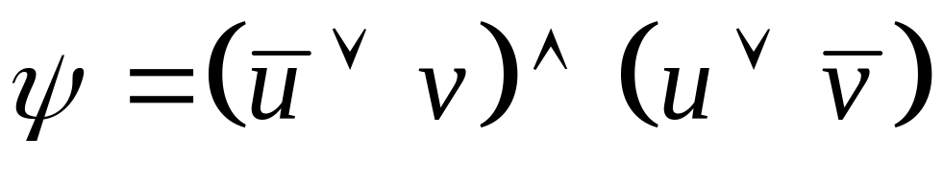
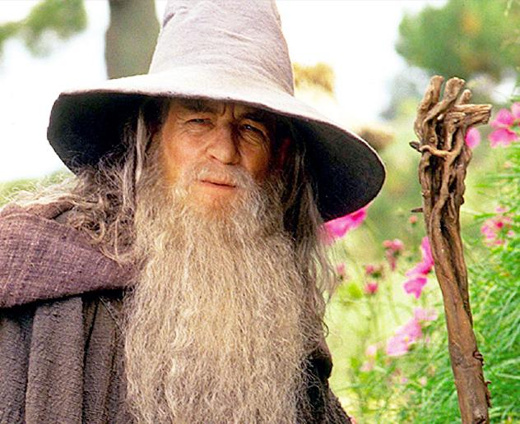
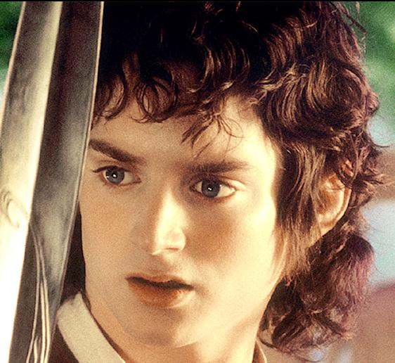
SAT as Proof Verification

Slide 33
SAT as Proof Verification
ψ is satisfiable
u = True; v = True

Slide 34
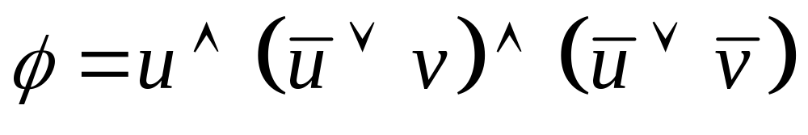
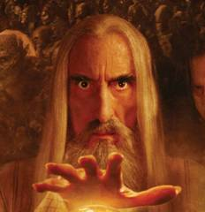
SAT as Proof Verification

Slide 35
SAT as Proof Verification
φ is satisfiable

Slide 36
SAT as Proof Verification
φ is satisfiable
Cannot produce
satisfying assignment

Slide 37
Verifying Unsatisfiability

Slide 38
Verifying Unsatisfiability
u = true; v = true

Slide 39
Verifying Unsatisfiability

Slide 40
Verifying Unsatisfiability
u = true; v = false

Slide 41
Verifying Unsatisfiability
Not possible unless NP = co-NP

Slide 42
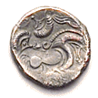
Interactive Proof System

Slide 43
Interactive Proof System
HTTHHHTH

Slide 44
Interactive Proof System
HTTHHHTH
010101000110

Slide 45
Interactive Proof System
HTTHHHTH
010101000110
THTHHTHHTTH
001111001010

Slide 46
Interactive Proof System
HTTHHHTH
010101000110
THTHHTHHTTH
001111001010
THTTHHHHTTHHH
100100011110101

Slide 47
Interactive Proof System
Developed in 1985 by Babai
and Goldwasser-Micali-Rackoff
HTTHHHTH
010101000110
THTHHTHHTTH
001111001010
THTTHHHHTTHHH
100100011110101

Slide 48
Interactive Proof System
Lund-Fortnow-Karloff-Nisan 1990: There is an interactive proof system for showing a formula not satisfiable.
HTTHHHTH
010101000110
THTHHTHHTTH
001111001010
THTTHHHHTTHHH
100100011110101

Slide 49
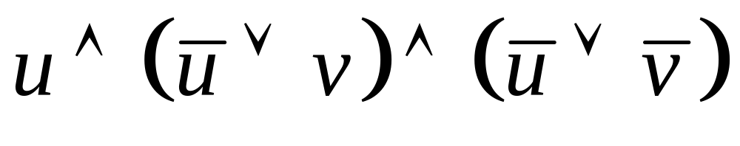
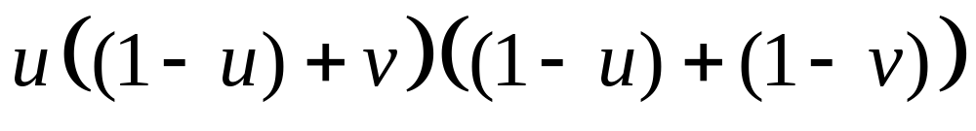
Interactive Proof for co-SAT
For any u in {0,1} and v in {0,1} value is zero.

Slide 50
Interactive Proof for co-SAT

Slide 51
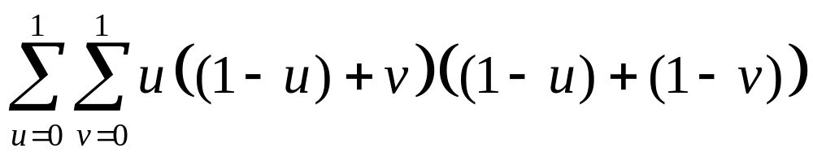
Interactive Proof for co-SAT
Value is zero.

Slide 52
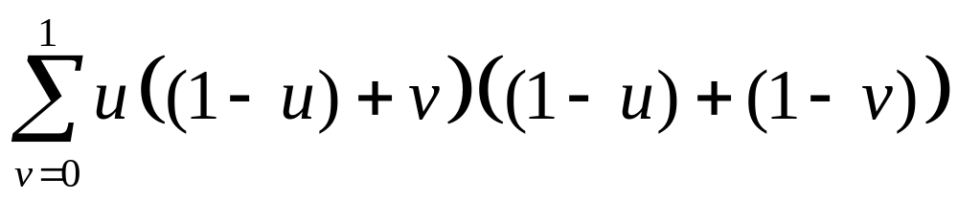
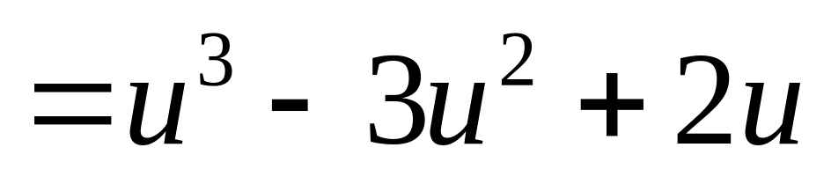
Interactive Proof for co-SAT

Slide 53
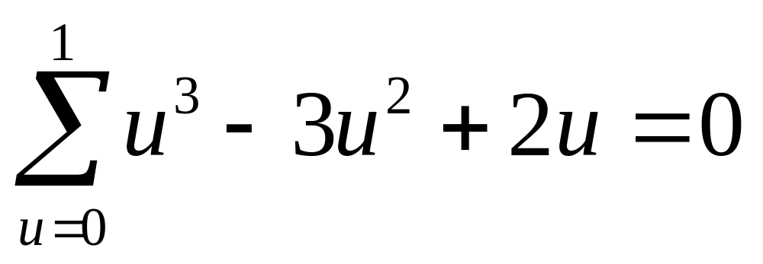
Interactive Proof for co-SAT

Slide 54
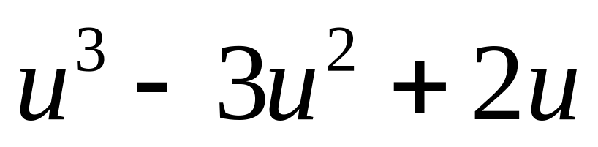
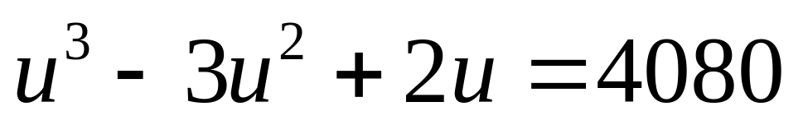
Interactive Proof for co-SAT
Picks u at random, say u = 17.

Slide 55
Interactive Proof for co-SAT
u = 17
4080

Slide 56
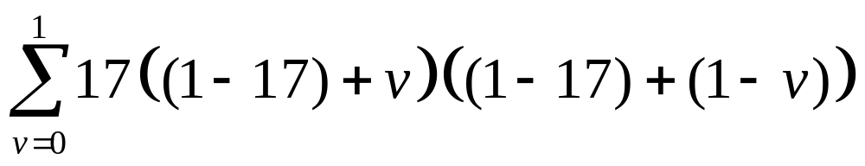
Interactive Proof for co-SAT
u = 17
4080

Slide 57
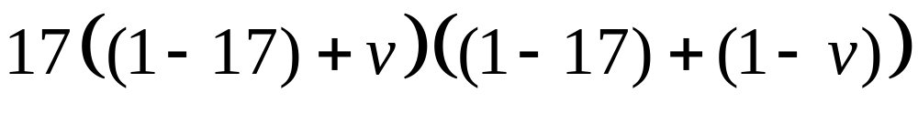
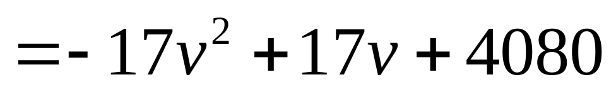
Interactive Proof for co-SAT

Slide 58
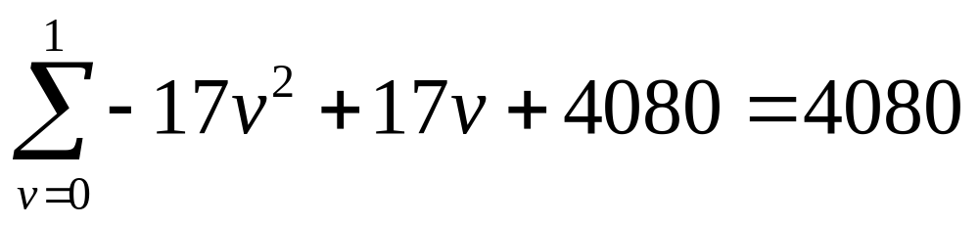
Interactive Proof for co-SAT
u = 17
4080

Slide 59
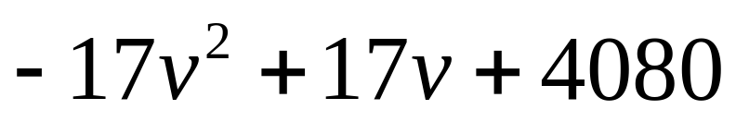
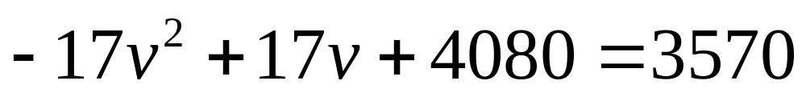
Interactive Proof for co-SAT
Pick random v, say v=6.
u = 17
v = 6
3570

Slide 60
Interactive Proof for co-SAT
Plug in 17 for u and 6 for v.
Evaluates to 3570.
A PERFECT MATCH!
u = 17
v = 6
3570

Slide 61
Interactive Proof for co-SAT
If formula φ was satisfiable then any evil prover would fail with high probability.
Uses fact that polynomials are low-degree.
Two low-degree polynomials cannot agree on many places.

Slide 62
Extensions
Shamir 1990
  Interactive Proof System for every PSPACE language.
GMW/BCC 1990
  SAT has interactive proof that does not reveal any information about the satisfying assignment.

Slide 63
Probabilistically Checkable Proof Systems

Slide 64
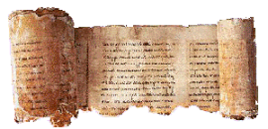
Probabilistically Checkable Proof Systems
Queries bits
of the proof
Defined by Fortnow-Rompel-Sipser 1988

Slide 65
Probabilistically Checkable Proof Systems
Queries bits
of the proof
Babai-Fortnow-Lund 1990
  PCP = NEXP

Slide 66
Probabilistically Checkable Proof Systems
Queries bits
of the proof
Babai-Fortnow-Levin-Szegedy 1991
  Roughly linear-size proof of SAT verifiable with small number of queries.

Slide 67
Probabilistically Checkable Proof Systems
Queries bits
of the proof
ALMSS 1991
  Proofs of SAT using constant queries and logarithmic number of random coins.

Slide 68
Probabilistically Checkable Proof Systems
Queries bits
of the proof
ALMSS 1991
  Many applications for showing hardness of approximation for optimization problems.

Slide 69
Hard to Approximate
Clique Size
Traveling Salesman
Max-Sat
Shortest Vector in Lattice
Graph Coloring
Independent Set
…

Slide 70
Are Two SAT Questions Better Than One?

Slide 71
Questions to SAT
Oracle willing to honestly answer
a limited number of SAT questions.
Does the number of queries matter?
Focus on what happens if two queries to SAT can be simulated by a single SAT query.

Slide 72
Are Two Queries Better Than One?
Series of results by
  Kadin 1988
  Wagner 1988
  Chang-Kadin 1990
  Amir-Beigel-Gasarch 1990
  Beigel-Chang-Ogihara 1993
  Buhrman-Fortnow 1998
  Fortnow-Pavan-Sengupta 2002

Slide 73
If One Query as Powerful as Two Queries …
Any polynomial number of adaptive SAT queries, can be simulated by a single SAT query.
Polynomial-Time hierarchy collapses to Symmetric Polynomial-Time.

Slide 74

Alternation

Slide 75
Alternation
Model invented
by CKS 1981.
Unbounded
Alternation
= PSPACE

Slide 76
Alternation
Model invented
by CKS 1981.
Constant
Alternation
=
Polynomial
Hierarchy

Slide 77
Symmetric P

Slide 78
Symmetric P
Defined by Russell
and Sundaram 1996

Slide 79
If One Query as Powerful as Two Queries …

Slide 80
If One Query as Powerful as Two Queries …

Slide 81
Hard-Easy Strings
If one query as powerful as two then for every unsatisfiable ψ, either
  There is a nondeterministic proof that
  ψ is not satisfiable, or
  One can use ψ as advice to solve satisfiability for all formulas of the same length.
Proofs use applications of this fact.

Slide 82
Is SAT the Same as Every Other NP-Complete Set?

Slide 83
NP-Completeness of SAT
Σ*
Σ*
SAT
f
A

Slide 84
Isomorphisms of SAT
Σ*
Σ*
SAT
f
A
A set A is isomorphic to SAT if A reduces to SAT via a 1-1, onto, easily computable and invertible reduction.

Slide 85
Are all NP-complete sets the same as SAT?
Σ*
Σ*
SAT
f
A
Berman and Hartmanis 1978
  All of the known NP-complete sets are isomorphic.

Slide 86
Are all NP-complete sets the same as SAT?
Σ*
Σ*
SAT
f
A
Berman and Hartmanis 1978
  Conjecture: All of the NP-complete sets are isomorphic.

Slide 87
Are all NP-complete sets the same as SAT?
Σ*
Σ*
SAT
f
A
If conjecture is true…
  All NP-complete sets, like SAT, must have an exponential number of strings at every length.

Slide 88
What if SAT reduces to a small set?
Mahaney’s Theorem (1978)
  For many-one reduction then P=NP.
Ogihara and Watanabe (1991)
  For reductions that ask a constant number of queries still P=NP.
Karp-Lipton(1980)/Sengupta(2001)
  For arbitrary reductions, polynomial hierarchy collapses to Symmetric-P.

Slide 89
Are all NP-complete sets the same as SAT?
Σ*
Σ*
SAT
f
A
Still Open
Look at relativized worlds
  Universes that show us limitations of most proof techniques.

Slide 90
Are all NP-complete sets the same as SAT?
Σ*
Σ*
SAT
f
A
Fenner-Fortnow-Kurtz 1992
  A relativized world where the isomorphism conjecture holds.

Slide 91
Can We Solve SAT Quickly on Other Models of Computation?

Slide 92



Solving SAT on Other Models of Computation
RANDOM
DNA
QUANTUM

Slide 93
Can we solve SAT Quickly with Random Coins?
Would imply collapse of the polynomial-time hierarchy.
Reasonable assumptions imply randomness computation not any stronger than deterministic computation.
  IW ’97: If EXP does not have subexponential-size circuits then we can derandomize.

Slide 94
Can we solve SAT Quickly with DNA Computing?
Adleman has solved TSP on 20 cities with DNA manipulation.
Problem: Exponential Growth

Slide 95
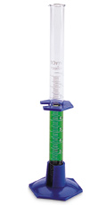
Exponential Growth
20 Cities

Slide 96
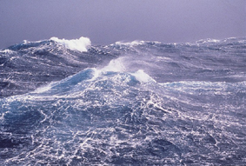
Exponential Growth
75 Cities

Slide 97
Can we solve SAT Quickly with DNA Computing?
Adleman has solved TSP on 20 cities with DNA manipulation.
Problem: Exponential Growth
Adleman
The less pleasing part is that we learned enough about our methods to conclude that they would not allow us to outperform electronic computers.

Slide 98
Can we solve SAT Quickly on a Quantum Computer?
Basic element is qubit that is in a superposition of zero and one.
N qubits can be entangled to form 2^{N} quantum states.
States can have negative amplitudes that can cancel each other out.
Transformations are limited to a unitary manner.

Slide 99
Can we solve SAT Quickly on a Quantum Computer?
Shor 1994
  Factoring can be solved quickly on a quantum computer.
Grover 1996
  Search a database of size N using N^{1/2} queries.
  Yields quadratic improvement for general satisfiability.
  Best possible in a black-box model.

Slide 100
Can we solve SAT Quickly on a Quantum Computer?
Fortnow-Rogers
  Relativized world where quantum computing is no easier than classical, yet
  P≠NP and the polynomial hierarchy does not collapse.
Physical Difficulties
  Maintain Entanglement
  Handle Errors
  High Precision

Slide 101
Other Research
Lower Bounds for proving non-satisfiabilility in weak logical models.
Circuit complexity approaches to lower bounds for satisfiability.
Solving SAT on “Typical” instances.
Many other structural questions about satisfiability.

Slide 102
Conclusions
The satisfiability question captures nondeterministic computation and much of the interest in computational complexity.
We have made much progress on these fronts but many questions remain.
Prove P≠NP!

